Slide 1


Customer Base Expansion Proposal for:
Prepared by:
Tristan Krause, Manager
Kevin Durkin
Mike Furgason
Alec Maghami
Karishma Sanghvi
September 28, 2009

Slide 2
Contents
Google Search
Eastside Entry Strategy
Customer Relationship Management
Website Redesign
Marketing Efforts

Slide 3



Google Search
The importance of improving Internet search results
The nature of how people find resources and services is changing
Away from traditional methods (mailers, yellow pages)
To internet searches valued for speed and convenience
Optimizing search results costs money
This money is a direct investment in potential future business
Google Search
Marketing Efforts
Eastside Entry Strategy
Customer Relationship Management
Website Redesign

Slide 4
Google Search
Methods for improving search results for the Bartlett Website
Google Analytics: a free tool providing valuable information
Bartlett can use this information to prioritize aspects of website redesign
Incorporate into front end:
Use only Bartlett name (using both dilutes search responses)
Incorporate into back end:
Work with Bartlett Corporate Marketing office
Add meta tags, pictures, frequent updates, Google Local
Ask strategic partners to link to Bartlett’s Kenmore Office page
Google Search
Marketing Efforts
Eastside Entry Strategy
Customer Relationship Management
Website Redesign

Slide 5
Website Redesign
Key objectives Of Four Seasons Tree Care website redesign
Former Four Seasons site to act as a resource for information specifically regarding the local branch
Use creative linking to forward major categories to the Bartlett site (“Services” tab, marketing materials, etc.)
Clearly communicate to customers the relationship between Bartlett and Four Seasons
Google Search
Marketing Efforts
Eastside Entry Strategy
Customer Relationship Management
Website Redesign

Slide 6


Website Redesign
Visual improvements to increase correlation between Bartlett and Four Seasons sites
Match the color schemes, fonts, and layout (look of the menu tabs, text positioning and sizing, etc.)
This will make the visual transition between links on the Four Seasons site to pages on the Bartlett site more seamless
Use the Bartlett logo on the home page
Google Search
Marketing Efforts
Eastside Entry Strategy
Customer Relationship Management
Website Redesign

Slide 7
Website Redesign
Content changes to improve correlation and reduce ambiguity
Use Four Seasons website to discuss ideas specific to the local branch
Create profiles and bios about the arborists (under the “About Us” tab), including pictures of Scott and Jake
Post pictures showing previous job sites and examples of visible local work the company has done
Match up congruent aspects of both sites
The Bartlett website has excellent resources and can more clearly communicate the added benefits the company can provide
Clean up the home page and clearly explain outright that this site represents the local division of Bartlett
Add links to local events and organizations under “Links” page
Google Search
Marketing Efforts
Eastside Entry Strategy
Customer Relationship Management
Website Redesign

Slide 8
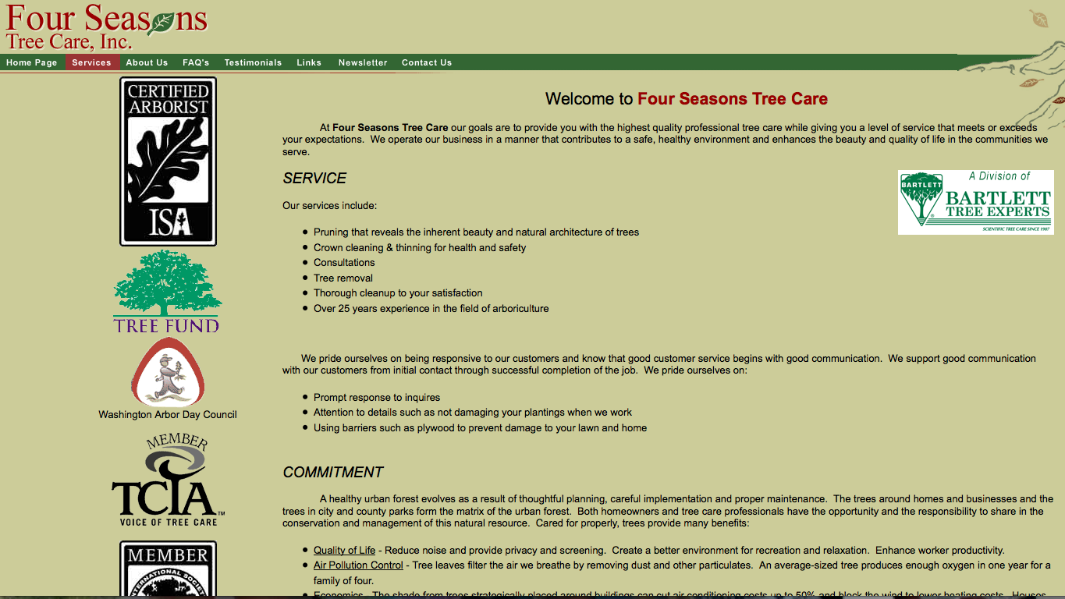
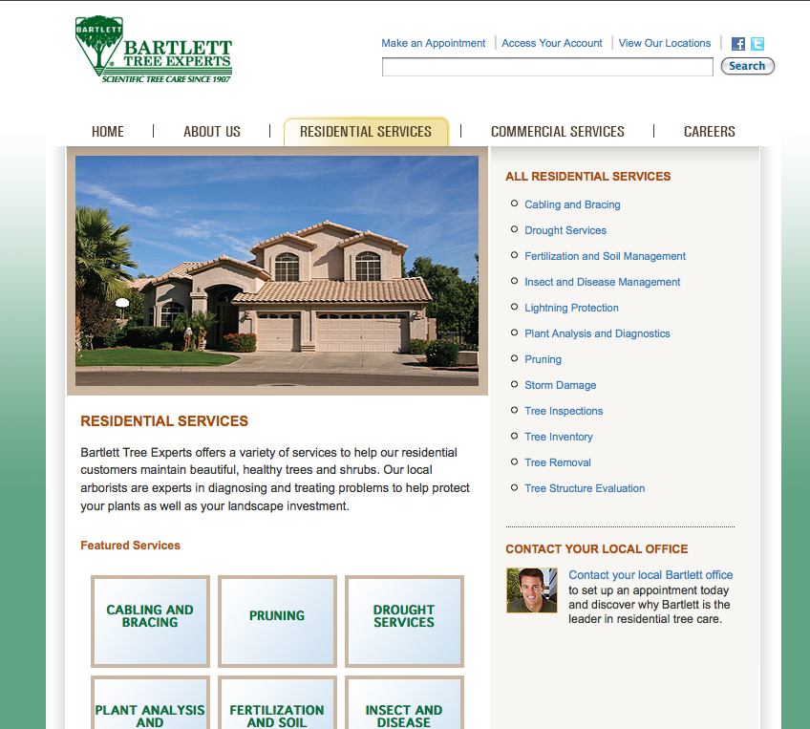
Website Redesign
Smart links can reduce ambiguity and clarify repetition
Hyperlink

Slide 9
Marketing Efforts
Quantitative comparison of marketing expenditures and benefits
2007
 | YTD $ | % total | Mktg Cost | ROI | Intangible Benefits:
FSTC Website | $13,535 | 1.98% | $228 | 5849% | Information for customers
Newsletter | $1,485 | 0.22% | $8,878 | -83% | Information, exposure, CRM
Online search | $13,633 | 1.99% | $0
Plant Amnesty | $19,633 | 2.87% | $920 | 2034%
Referrals (general) | $182,603 | 26.68% | $0 |  | Word of mouth
Yellow Pages | $22,450 | 3.28% | $8,446 | 166%
2008 (Jan-June)
 | YTD $ | % total | Mktg Cost | ROI | Intangible Benefits:
FSTC Website | $1,285 | 0.61% | $0 |  | Information for customers
Newsletter | $0 | 0.00% | $5,787 |  | Information, exposure, CRM
Online search | $8,465 | 4.00% | $0
Plant Amnesty | $9,065 | 4.29% | $420 | 2158%
Referrals (general) | $58,645 | 27.73% | $0 |  | Word of mouth
Yellow Pages | $15,117 | 7.15% | $5,141 | 294%
Google Search
Marketing Efforts
Eastside Entry Strategy
Customer Relationship Management
Website Redesign
Notes:
As previously mentioned, some budgeting toward online search improvement could yield positive ROI, especially if the money for these efforts were simply deferred from another marketing expenditure, such as newspapers or magazines.
While the newsletter represents a significant cost it does offer intangible benefits that can still be appreciated outside of the numbers.
Yellow Page advertising does continue to be profitable and shouldn’t be abandoned, but the expensive heavy advertising in the Eastside Yellow Pages may want to be abandoned in favor of different entry strategies, which we will discuss later.

Slide 10

Marketing Efforts
Qualitative discussion of marketing opportunities
Changing nature in the field of marketing
People can find an array of information instantaneously
Know where to look to find services
Threats:
Traditional efforts may not yield same ROI
Other companies may be better positioned
Opportunities:
Establishing significant customer networks
No-risk exposure through free online services
Potential to expand customer base at low cost
Google Search
Marketing Efforts
Eastside Entry Strategy
Customer Relationship Management
Website Redesign
Notes:
As we mentioned earlier, the nature of marketing is rapidly evolving which creates both threats and opportunities
People can easily find a wider array of information instantaneously
People tend to know where to look to find services, the most important thing companies can do to respond is to establish itself in these venues.
Threats:
Traditional marketing efforts may not be as effective, and money invested in Yellow Pages may not provide the same return it once did
Other companies with greater resources may be better positioned to capitalize on new opportunities
Opportunities:
Establishing significant customer networks
Free exposure through online services (Facebook, Craigslist links from strategic partners’ web pages)
If Bartlett can put itself in a position to capitalize on these opportunities, it can reap significant benefits and grow its customer base without paying significant expenses

Slide 11
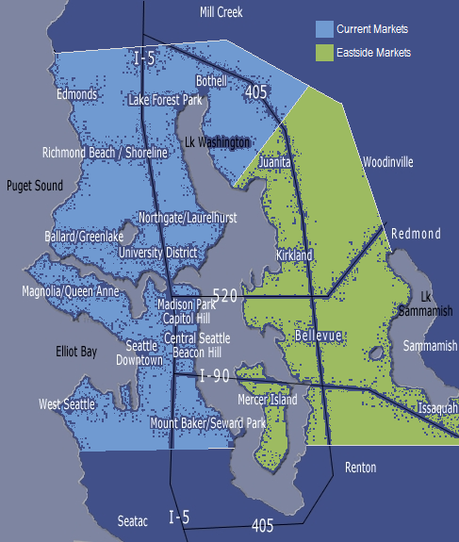
Eastside Entry Strategy
Overview of current and potential markets
Current market focus includes: Seattle (North of 1-90 corridor), Edmonds, and North Lake Washington Communities.
Eastside expansion focus includes: Juanita, Kirkland, Bellevue (including Medina, Clyde Hill, Hunts Point, and Yarrow Point), Mercer Island, Newcastle, and some Issaquah communities.
Google Search
Marketing Efforts
Eastside Entry Strategy
Customer Relationship Management
Website Redesign

Slide 12
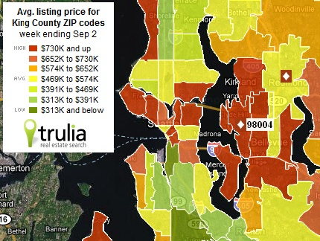
Eastside Entry Strategy
Eastside Statistics (Focus area excludes Woodinville, Renton, and Sammamish)
Population – 523,157
Med Household Income - $90,275
Med House Price - $577,656
% of Population in Multifamily Housing – 38.6% (Bellevue)
Average lot size (Single family home in Bellevue) - .27 acres.
Emphasis on parks and green space
Google Search
Marketing Efforts
Eastside Entry Strategy
Customer Relationship Management
Website Redesign

Slide 13
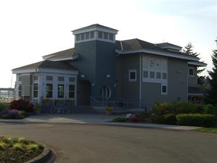
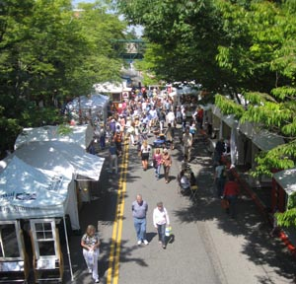

Eastside Entry Strategy
Establishing relationships in communities
Trust – Required in all work involving homes, gardens, personal property, etc.
Word of Mouth/ Referrals – The best indirect way of gaining trust
Dozens of small communities on the Eastside
Communities share experience and knowledge
Target community centers (ex. rec clubs, city halls, co-ops, nurseries)
Google Search
Marketing Efforts
Eastside Entry Strategy
Customer Relationship Management
Website Redesign

Slide 14
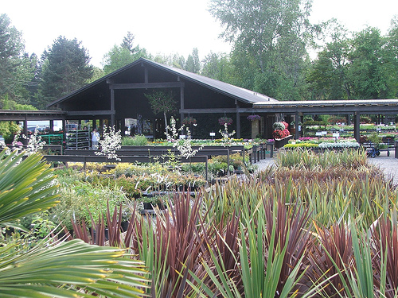
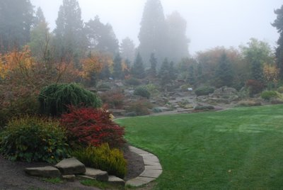
Eastside Entry Strategy
Establishing relationships in communities
With high-end clientele, exposure is critical
Maximize face-time by participating in community events (ex. fairs, nursery workshops, Co Ops, Gardening with Ciscoe)
Direct exposure allows you to showcase services and diagnose problems
Build relationships while sharing knowledge
Google Search
Marketing Efforts
Eastside Entry Strategy
Customer Relationship Management
Website Redesign

Slide 15
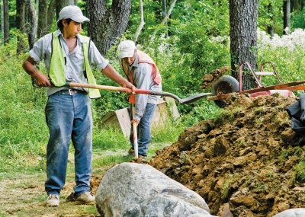
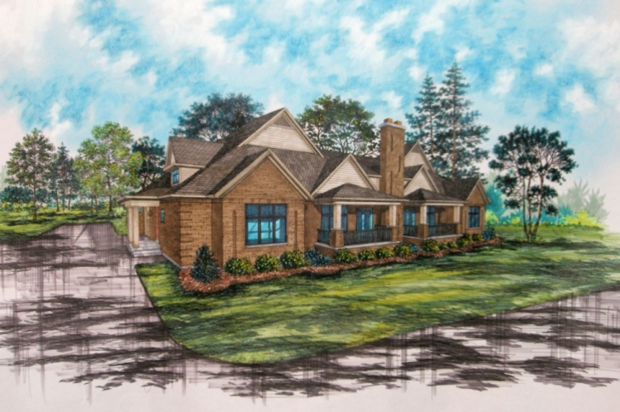
Eastside Entry Strategy
Establishing new avenues for strategic partnerships
Referrals and collaboration go hand in hand
Go after Eastside businesses that incorporate tree and landscaping care
Property managers, real-estate developers, nurseries, contractors, and landscapers
Take advantage of overlapping work to develop partnerships
Contact sources: yellowpages.com, bellevuelandscapers.com, dexknows.com
Google Search
Marketing Efforts
Eastside Entry Strategy
Customer Relationship Management
Website Redesign

Slide 16

Eastside Entry Strategy
New customer base expansion tactics
Use press-building tactics by pursuing highly visible jobs
Possibility of low-cost, complimentary work to establish trust with elusive high-profile clients (Gets a foot in the door)
Provide advice in renovations of older properties
Collect high-profile clients and KEEP THEM
Google Search
Marketing Efforts
Eastside Entry Strategy
Customer Relationship Management
Website Redesign

Slide 17
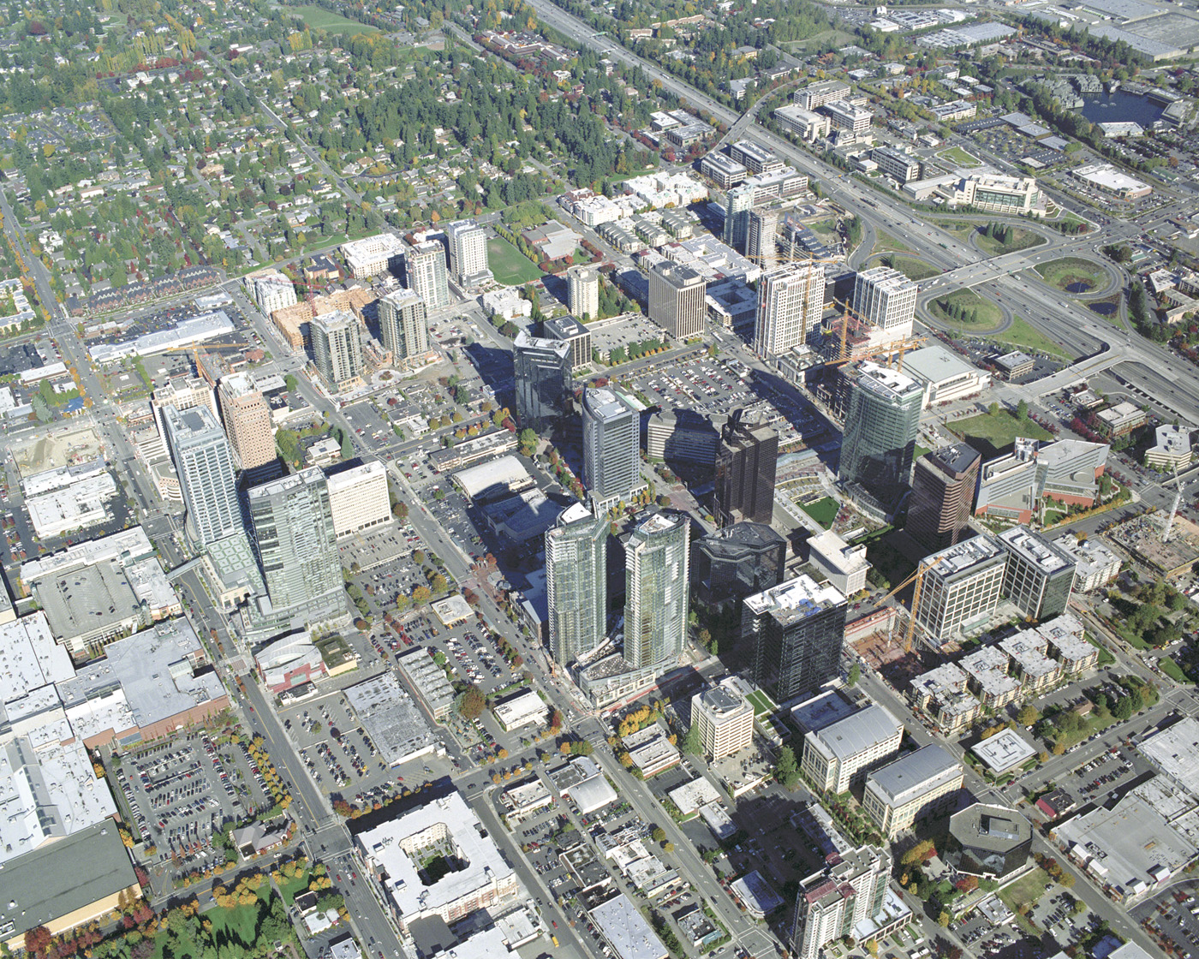

Slide 18

Customer Relationship Mgmt.
Utilizing systems to improve customer relationship management
Current systems provided by Bartlett allow for management of existing client information and processes
Establish a system for organizing prospect and lead profiles resulting from current client referrals
Look into joining a paid customer lead service
Ex: www.Leads.com, Sales Force, Leads 360
Google Search
Marketing Efforts
Eastside Entry Strategy
Customer Relationship Management
Website Redesign

Slide 19
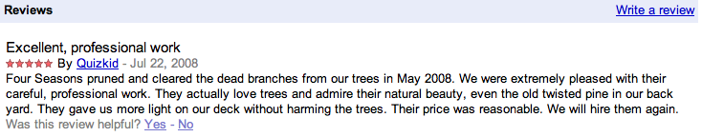
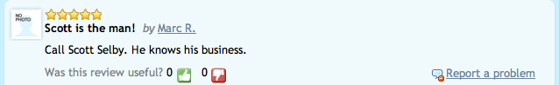
Customer Relationship Mgmt.
Encourage current clients to post reviews
Tap into various internet resources for positive review opportunities
Below is an actual review from Google Maps Reviews:
Below is a review from www.JudysBook.com:
Google Search
Marketing Efforts
Eastside Entry Strategy
Customer Relationship Management
Website Redesign
Notes:
- Asking customers to follow up by posting good reviews can be a method of communicating the legitimacy of the company (not just a truck and chainsaw operation)
- When following up with customers after jobs are complete, send an email with a list of links they can click on to fill out reviews that will help the business. If they are as ecstatic about the job you do as these 2 examples are, they would be more than willing to help out the company and future customers in need.

Slide 20
Thank You!
On behalf of Montlake Consulting group, thank you for granting us the unique opportunity to work with your company.
Google Search
Marketing Efforts
Eastside Entry Strategy
Website Redesign
Customer Relationship Management

Slide 21
Questions/Open Discussion
Google Search
Marketing Efforts
Eastside Entry Strategy
Website Redesign
Customer Relationship Management

